Slide 1

Parking and Accident Analysis
Archana N. Shagoti
Assistant Professor
Department of Civil Engineering

Slide 2
Syllabus
Parking, On Street and Off Street Parking studies and configuration
Design of layout
Accident, Causes, Data Collection and Analysis
Derivation for collision, Collision and condition diagrams (right angle collision only with parked vehicle)
Measures to reduce accidents, Problems on above.
Field Data Collection and Analysis related to Accidents.
Arboriculture.

Slide 3
Parking
Parking is one of the major problems that is created by the increasing road traffic.
•It is an impact of transport development.
•The availability of less space in urban areas has increased the demand for parking space especially in areas like Central business district.
•This affects the mode choice also.
• This has a great economical impact.

Slide 4
Parking statistics
Before taking any measures for the betterment of conditions, data regarding availability of parking space, extent of its usage and parking demand is essential.
It is also required to estimate the parking fares also.
Parking surveys are intended to provide all these information.
Since the duration of parking varies with different vehicles, several statistics are used to access the parking need

Slide 5
Need for Parking
Short Duration parking
Long Duration parking
Parking for loading and unloading operations near destination

Slide 6
Ill effects of Parking
Congestion-reduction in the effective width of the carriageway for the moving traffic and result in substantial reduction in the roadway capacity
Accidents-parking and unparking problems for unskilled drivers
Obstruction to fire fighting operations- access to buildings is less
Environment-stopping and starting of vehicles result in noise and fumes, less visual aesthetics.

Slide 7
Parking Space Requirements
Tentative Recommendations on the provision of parking Spaces for Urban Areas, Special Publication 12, IRC New Delhi, 1973.

Slide 8
Parking statistics
Parking accumulation
Parking volume
Parking load
Average parking duration
Parking turnover
Parking index

Slide 9
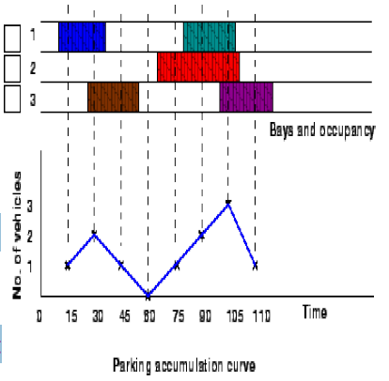
Parking accumulation:
It is defined as number of vehicles parked at a given the instant of time.
Normally this is expressed by accumulation curve.
Accumulation curve is the graph obtained by plotting the number of bays occupied with respect to time

Slide 10
Parking volume:
Parking volume is the total number of vehicles parked at a given duration of time.
This does not account for repetition of vehicles.
The actual volume of vehicles entered in the area is recorded.
Parking load :
Parking load gives the area under the accumulation curve.
It can be obtained by multiplying the number of vehicles occupying the parking area at each time interval with the time interval.
It is expressed as vehicle hours.

Slide 11
Average parking duration:
It is the ratio of total vehicle hours to the number of vehicles parked
AVD=Parking Load / Parking volume
Parking turnover:
–It is the ratio of number of vehicles parked in a duration to the number of parking bays available.
–This can be expressed as number of vehicles per bay per time duration.
Parking turnover =Parking volume /Number of bay

Slide 12
Parking index:
Parking index is also called occupancy or efficiency.
It is defined as the ratio of number of bays occupied in a time duration to the total space available.
It gives an aggregate measure of how effectively the parking space is utilized
Parking Index= (Parking load /Parking capacity)

Slide 13
Example
To illustrate the various measures, consider a small example in figure , which shows the duration for which each of the bays are occupied(shaded portion).
Now the accumulation graph can be plotted by simply noting the number of bays occupied at time interval of 15, 30, 45 etc. minutes as shown in the figure

Slide 15
Parking volume = 5 vehicles.
Parking load = (1 + 2 + 1 + 0 + 1 + 2 + 3 + 1 ) x 15/60
= 2.75 veh per hour
Average parking duration = 2.75/5 veh= 33minutes.
Parking turnover =5veh /2hour/3bay = 0.83 veh/hr/bay.
Parking index = {2.75 /(3slot x2hrs)] x 100= 45.83%

Slide 16
Parking surveys
Parking surveys are conducted to collect the parking statistics.
The most common parking surveys conducted are
In-out survey,
Fixed period sampling and
License plate method of survey.

Slide 17
In-out survey:
The occupancy count in the selected parking space is taken at the beginning.
Then the number of vehicles that enter the parking space for a particular time interval is counted.
The number of vehicles that leave the parking space is also taken.
The final occupancy in the parking space is also taken.
But we wont get any data regarding the time duration for which a particular vehicle used that parking lot.
–Parking duration and turn over is not obtained.
–Hence we cannot estimate the parking fare from this survey.
– Here the labor required is very less.

Slide 18
Fixed period sampling:
This is almost similar to in-out survey.
All vehicles are counted at the beginning of the survey.
Then after a fixed time interval that may vary between 15 minutes to 1 hour, the count is again taken.
Here there are chances of missing the number of vehicles that were parked for a short duration.

Slide 19
LICENCE PLATE METHOD
This results in the most accurate and realistic data.
Every parking space is monitored at a continuous interval of 15 minutes or so and the license plate number is noted down.
This will give the data regarding the duration for which a particular vehicle was using the parking bay.
This will help in calculating the fare because fare is estimated based on the duration for which the vehicle was parked.
But this method is very labor intensive.

Slide 20
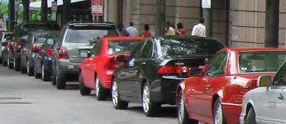
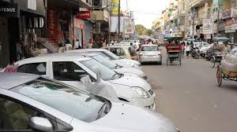
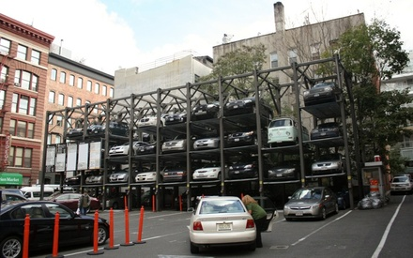
TYPES OF PARKING
On street Parking
Off street Parking

Slide 21
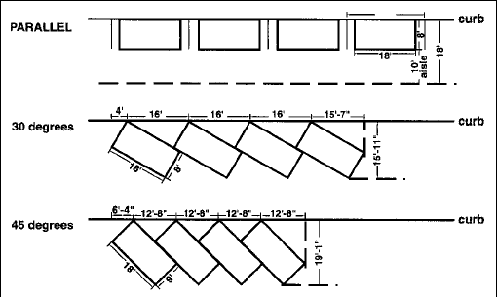
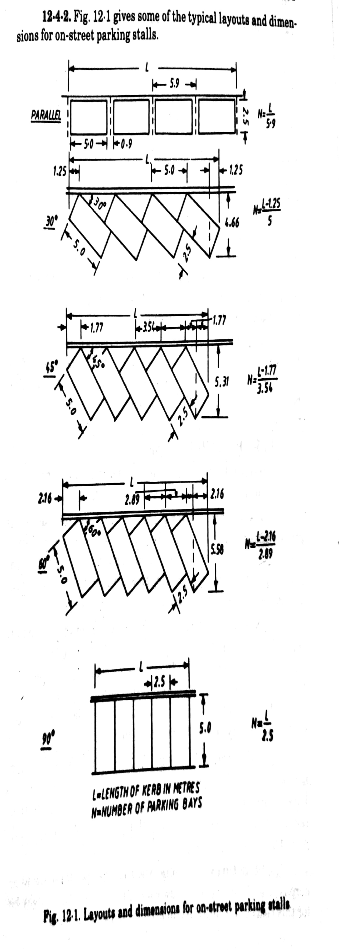

Types of On-street Parking
Parallel parking
2. 30° angle Parking
3. 45° angle Parking
4. 60° angle Parking
5. Right angle Parking

Slide 22
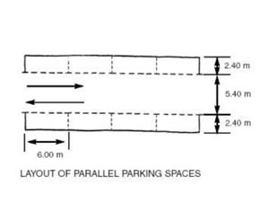
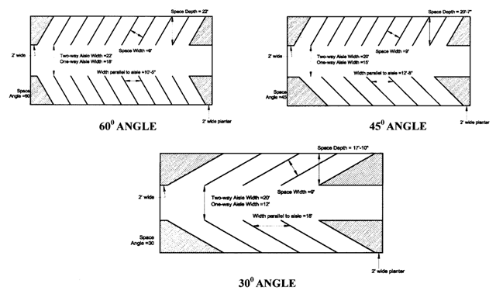
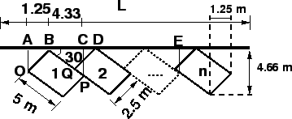

Slide 23
Points to remember
Parallel parking consumes the maximum length which decreases as the angle of parking increases.
It makes the least use of width of the street which is an important consideration in narrow streets.
Minimum kerb length is consumed by right angle parking which accommodates nearly 2 times the number of vehicles as parallel parking
As parking angle increases the width of street used also increases.
Delay to traffic is minimum with angle parking.
In regards to safety against accidents, angle parking is hazardous than parallel parking.

Slide 24
Types of Off-street Parking
Surface Car Parks
Multi storey Car Parks
Roof Parking
Mechanical Car Parks
Underground Car Parks

Slide 25
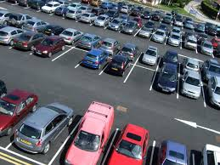
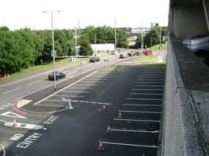
Surface Car Parks
Great care is needed in their design and operation
The overall aesthetics of the area should receive due attention
A stall size of 2.5 X 5 m is probably adequate for Indian Conditions for small size cars

Slide 26
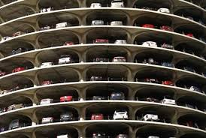
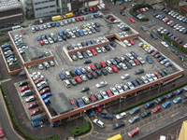
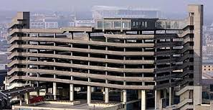
Multi storey Car Parks
Surface parks consume too much of precious land in the heart of city and are not therefore always feasible.
Multi storey car parks are designed for a capacity of about 400 to 500 cars.
Larger capacity leads to increase in the time for unparking a car.

Slide 27
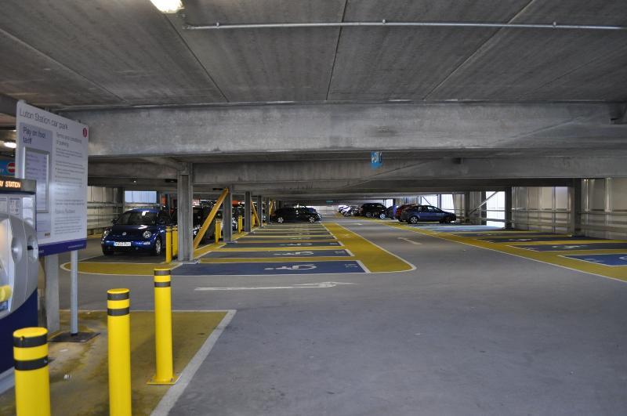
Desirable standards
Gradient of ramp : 1:10 generally
: 1:08 for very short ramps
Clear height between floors : 2.1 m
Parking stall dimensions : 2.5 X 5 m
Inside radius of curves : 7m
Width of traffic lane on ramps & entrance: 3.75m
Gradient of sloping floors : not steeper than 1:20
Loading Standards : 400 kg/m2

Slide 28
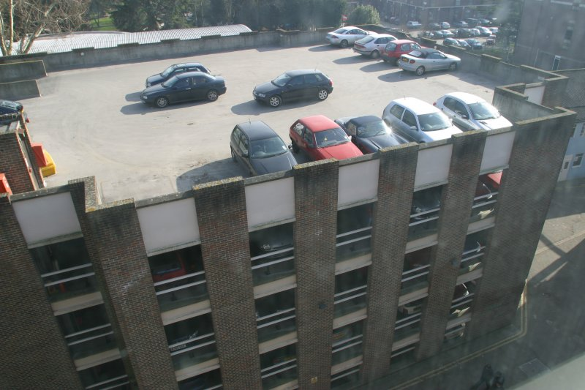
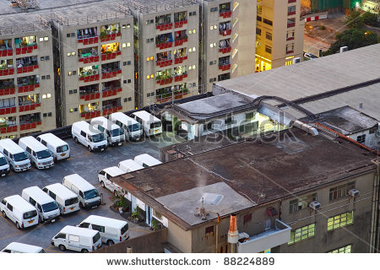
Roof Parks
A very popular method of solving parking problems
Access ramps or mechanical lifts provide necessary access to the roofs
To economies, roofs should be linked together.
Structural elements should be designed for parking loads

Slide 29
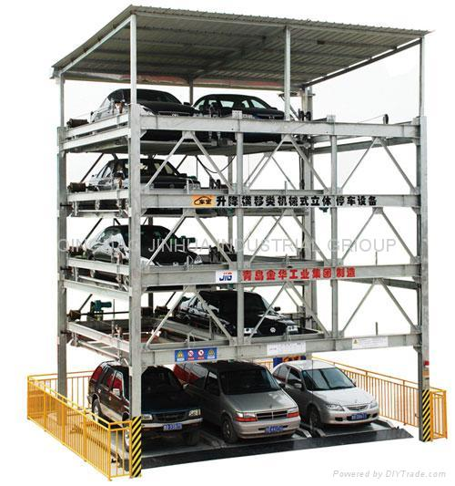
Mechanical Car Parks
They provide lifting mechanism of the cars from floor to floor by means of a lift
Transfer of cars to and from floors by means of wheeling or mechanically operated cradles.
Since ramps are eliminated here. It is more economical.

Slide 30
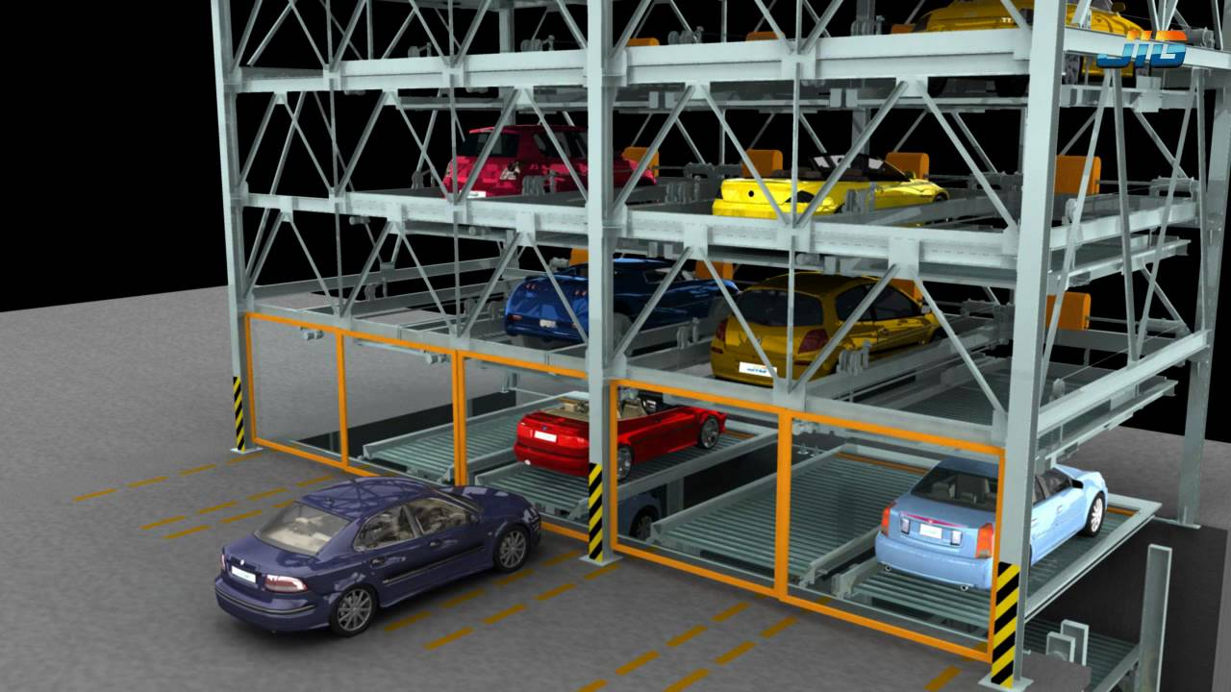

Slide 31
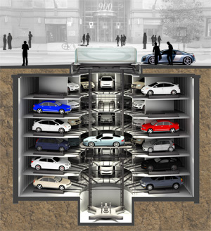
Underground Car Parks
Least intrusion to the aesthetics of the place
Can be built in the basement of any multi storey building or below open spaces
Costly construction process
Single storey or Multi storey

Slide 32
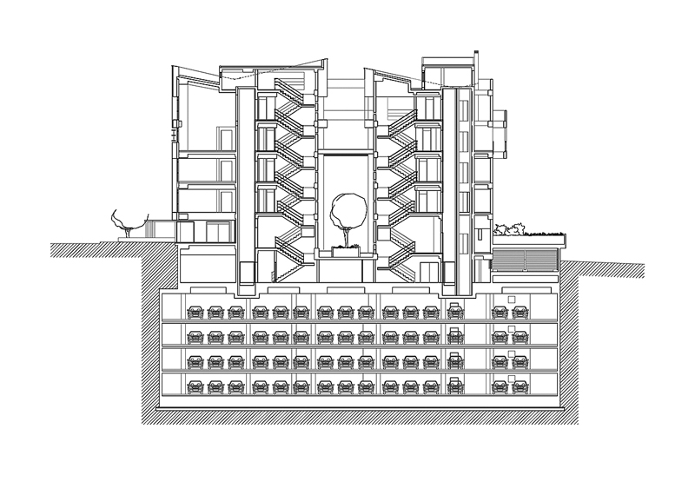
Underground Car Parks
Least intrusion to the aesthetics of the place
Can be built in the basement of any multi storey building or below open spaces
Costly construction process
Single storey or Multi storey

Slide 33
Parking Regulatory Measures
No Parking
Odd / even days parking
Left / right lane parking only
Parking meters
Parking fees collection

Slide 34
Accident Studies and Analysis

Slide 35
Importance of accident studies
Importance of accident studies
The problem of accident is very acute in road transportation due to:
(i) complex flow patterns of vehicular traffic
(ii) presence of mixed type of vehicles and
(iii) the pedestrians on the roads.
Traffic accidents may involve property damages, personal injuries and also deaths.

Slide 36
Importance of accident studies
One of the main objectives of traffic engineering is to provide safe traffic movements.
The accident studies pertain to the road accidents that occur from time to time on an existing road system.
Though road accidents cannot be totally prevented, the accident rate can be decreased substantially by suitable traffic engineering and management measures.
It is essential to analyze every individual accident and to maintain zone-wise accident records.
The statistical analysis of accidents-carried out periodically at critical locations or road stretches or zones or a city will help to arrive at suitable measures to effectively decrease the accident rates.

Slide 37
Accident Studies and Analysis
Importance
Objectives
To study the cause of accidents and to suggest corrective treatment at potential locations
To evaluate existing design, regulation and control measures
To support proposed changes in design, regulation and control measures in the selected zone
To carry out before and after studies after implementing changes and to demonstrate the improvement in the accident problem
To compute the financial losses incurred

Slide 38
Basic elements in traffic accident…
Road user
Vehicle
Road and its condition
Traffic
Environmental factors such as weather, visibility

Slide 39
Causes of accidents
Drivers- excessive speed, rash driving, carelessness, violation of rules, fatigue, sleeplessness, effect of alcohol.
Vehicle- defects such as failure of brakes, steering system, tyre burst, lighting system.
Road condition- skidding road surface, potholes, ruts.
Road design- defective geometric design like inadequate sight distance, inadequate width of shoulders, improper curve design, improper traffic control devices and improper lighting.

Slide 40
Environmental factors- unfavourable weather conditions like mist, snow, smoke and heavy rainfall which restrict normal visibility and makes driving unsafe.
Other causes- improper location of advertisement boards, gate of level crossing not closed when required etc..

Slide 41
TYPES OF ACCIDENTS:
Fatal accidents: An accident in which one or more persons were killed.
Grievous injury accident: Accidents in which persons were grievously injured. For example permanent disfigurement of head or face.
Slightly injured accidents: Persons who have sustained only minor injuries or bruises or sprains.
Minor injury accidents: Accidents in which persons received only minor injuries.
Non-injury accidents: Accidents in which no one was killed or injured

Slide 42
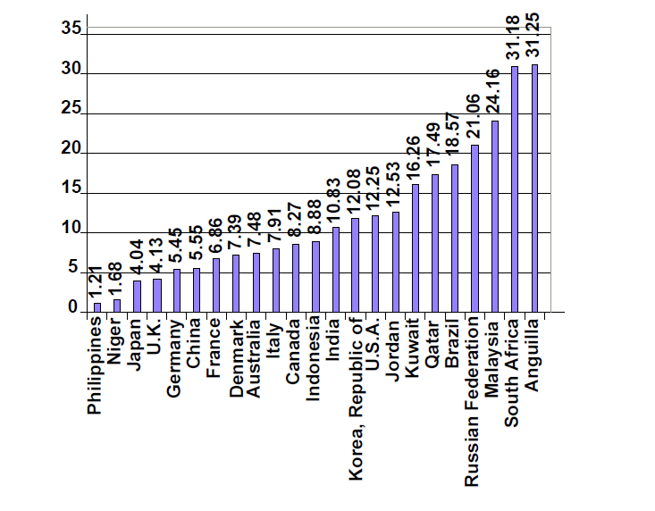
Accident Statistics

Slide 43
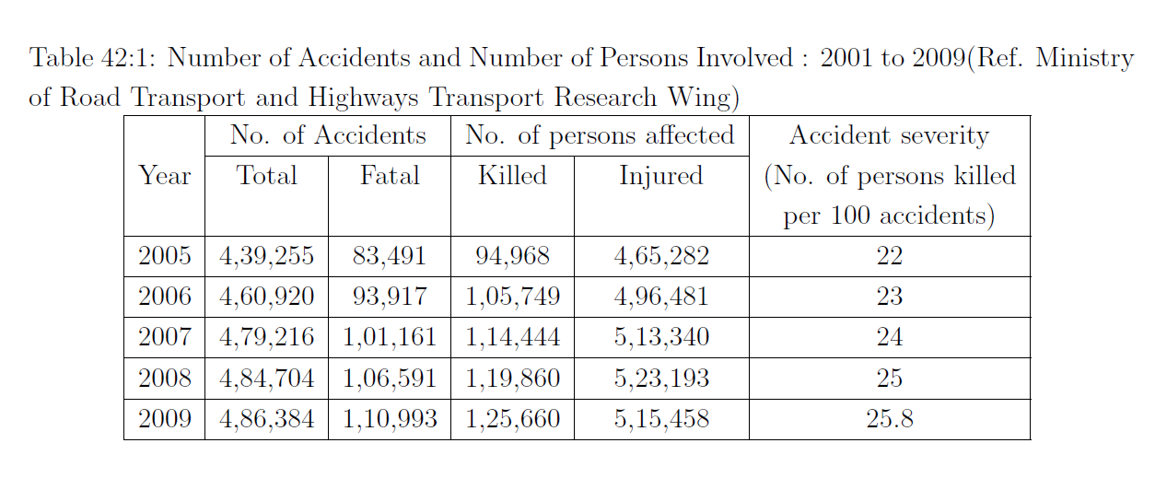

Slide 44
ACCIDENT STUDIES AND RECORDS
The various steps involved in traffic accident studies are,
(i) collection of accident data
(ii) preparation of accident reports
(iii) preparation of location file
(iv) preparation of diagrams showing the type of collision and
(v) application of the above records for suggesting measures to prevent similar accidents at the same location.

Slide 45
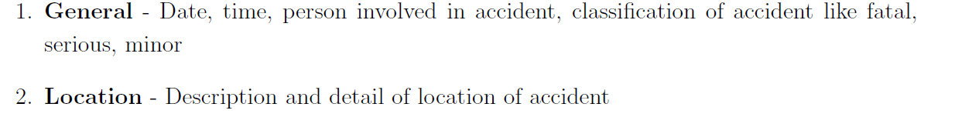
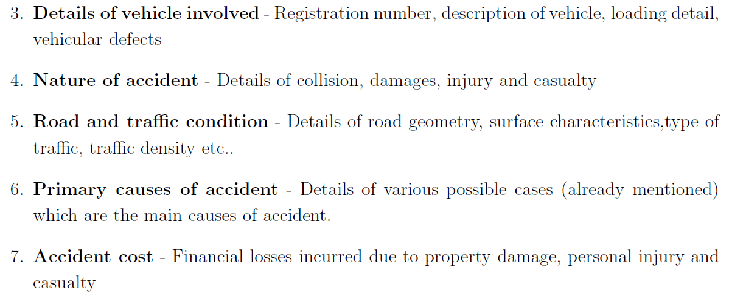
Accident data collection

Slide 46
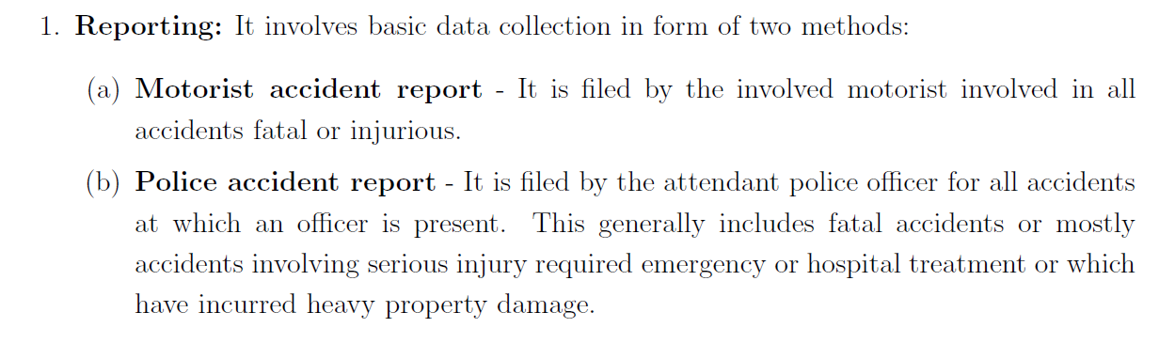
Accident Investigation

Slide 47
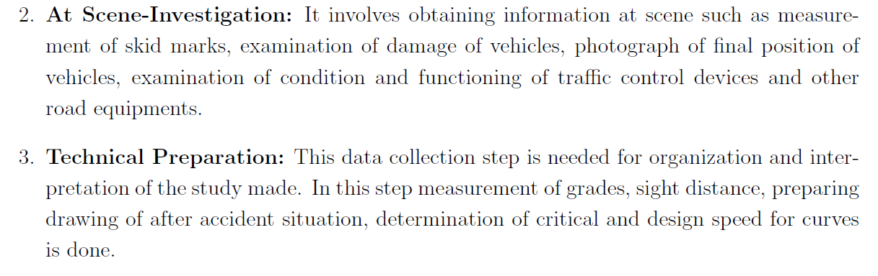

Slide 48
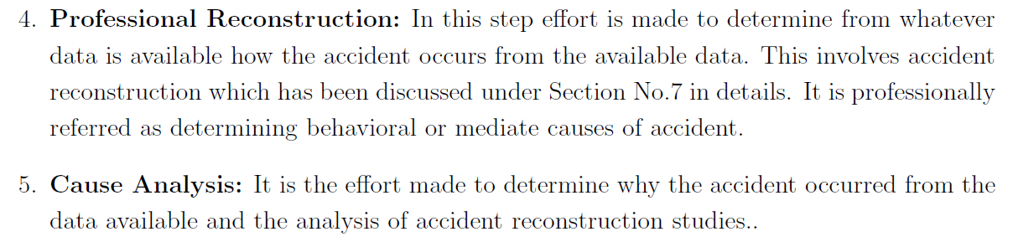

Slide 49
Accident records
Location files
Spot maps
Collision diagram
Condition diagram

Slide 50
Location Files
Maintained by each police station for the respective jurisdiction
Useful to keep a record of the locations where accidents have taken place
Useful in identifying the locations of high accident incidence

Slide 51

Spot Maps
Accident location spot maps show - accidents by spots, pins or symbols on the road map of the locality.
• A map of suitable scale, say 1 mm = 4 to 6m, may be used for the preparation of spot maps of urban accidents.

Slide 52
Spot Maps
The traffic section posts accident locations on the map by using different colored map pins.
Color of the pins can be used to represent different factors.
Maps should be large enough for easy visibility.
By reviewing these maps, high accident locations can be seen.
At the end of each year, maps should be photographed in color and filed for future reference and comparison with current maps

Slide 53
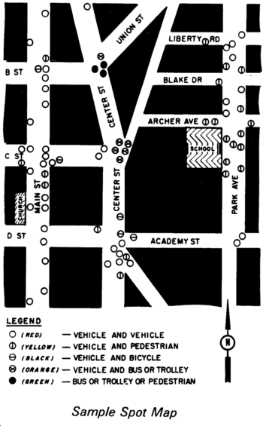

Slide 54
Collision diagram
These diagrams depict the details of the accident location (not drawn to scale) and show the approximate path of the vehicles and pedestrians involved in the accident and also other objects with which the vehicles have collided.
Collision diagrams are most useful to compare the accident pattern before and after the remedial measures have been taken.

Slide 55
Collision Diagram
The diagram consists of an outline map of the location and symbols showing
the direction of movement of vehicles and pedestrians involved in accidents.
If stationary objects are important in accidents, they are included in he diagram.
Each diagram should include:
Drawing of intersection.
Identification of diagram.
Identification of streets.
Plots of accidents to include: Direction of travel. Date of accident. Time. Road conditions. Weather conditions. Any unusual conditions (flood, storm, intoxication, etc.).

Slide 56
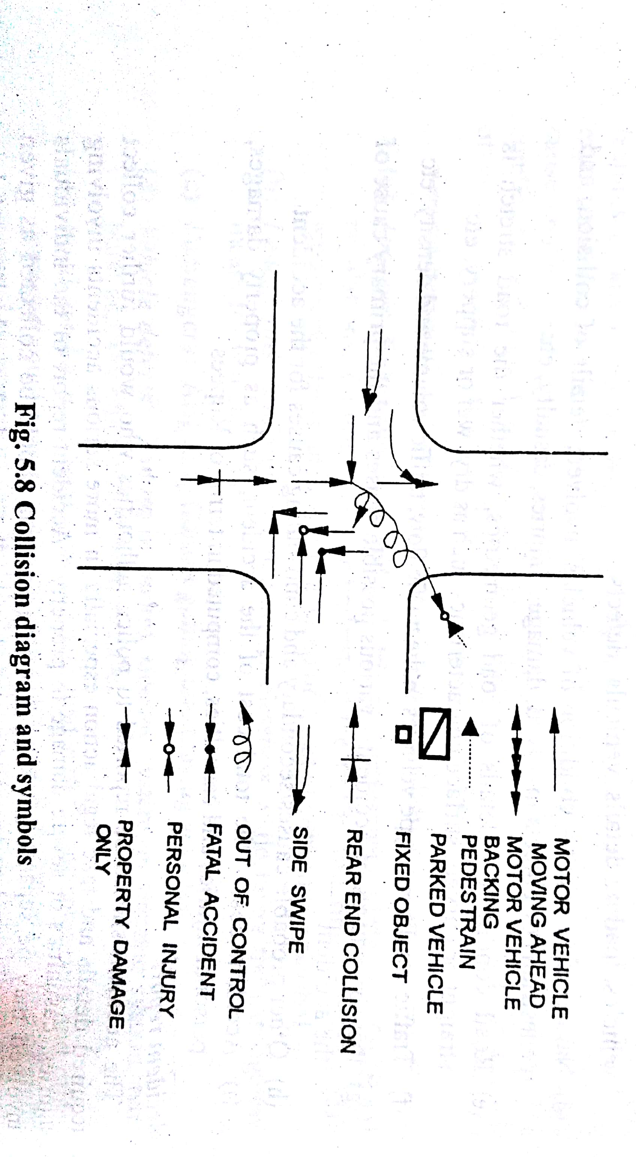
Collision diagram

Slide 57
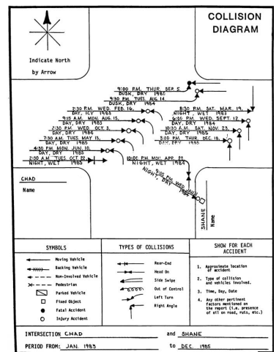
Collision diagram

Slide 58
Collision Diagram
After a diagram has been prepared, make a search for points of similarity.
These may be:
All accident cars coming from the same direction.
Colliding cars coming from the same directions such as northbound and eastbound.
Accidents of one type, such as cars turning left.
Accidents occurring during one season of the year.
Accidents occurring at a certain time of day or during certain lighting conditions.
Accidents occurring under the same weather conditions.

Slide 59
Condition Diagram
A condition diagram is a drawing of the accident location drawn to scale, showing all the important physical features of the road and adjoining area.
• The important features generally to be shown in the condition diagram with their dimensions marked there-in are:
the width of roadway, shoulders, median if any othergeometric details such as curves, kerb lines, bridges, culverts, electric posts, trees and all details of roadway conditions, obstruction to vision, property lines, signs, signals, etc.

Slide 60
Condition Diagram
From this diagram the required visibility distance for the 85th percentile speed on the road, and the actual visibility triangle can be made.
This will allow an evaluation of the effects obstructions have on the driver's view and road conditions.
Standard symbols are used in showing various details.
The condition and collision diagrams may be combined together in a single sketch, ifnecessary

Slide 62
Preventive measures of accidents ( Engineering measures , enforcement, education )
Road design
▪ The geometric design features of the road such as sight distances, width of pavement, and width of shoulders, horizontal and vertical alignment design details and intersection design elements are checked and corrected if necessary.
▪ The pavement surface characteristics including the skid resistance values are checked and suitable maintenance steps taken to bring them up to the design standards.
▪ Where necessary lay-passes may be constructed to separate through traffic from local traffic.
▪ To minimize delay and conflicts at the intersections, it may be essential to design and construct grade separated intersections or flyovers with interchange facilities.

Slide 63
Preventive measures of accidents ( Engineering measures , enforcement, education )
Preventive maintenance of vehicles
The braking system, steering, indicators, lighting system and condition of tires of vehicles plying on the roads are to be checked at suitable intervals and heavy penalties levied on defective vehicles.
• These measures are particularly necessary for public carriers.

Slide 64
Preventive measures of accidents ( Engineering measures , enforcement, education )
Before and after studies
▪ The record of accidents and their patterns for different locations are maintained by means of collision and condition diagrams.
▪ After making the necessary improvements in engineering design, regulations, enforcements and educational drives (covered under the '3-Es'), it is again necessary to collect and maintain the record of accidents.
▪ The accident record supplemented with collision and condition diagrams during the past two or three years are compared with similar data collected after implementing the improvement measures for the identical duration.
▪ Such studies are called 'before and after studies' in order to compare the reduction in accident rate, if any and the effectiveness of different preventive measures introducedc) Before and after studies

Slide 65
▪ The record of accidents and their patterns for different locations are maintained by means of collision and condition diagrams.
▪ After making the necessary improvements in engineering design, regulations, enforcements and educational drives (covered under the '3-Es'), it is again necessary to collect and maintain the record of accidents.
▪ The accident record supplemented with collision and condition diagrams during the past two or three years are compared with similar data collected after implementing the improvement measures for the identical duration.
▪ Such studies are called 'before and after studies' in order to compare the reduction in accident rate, if any and the effectiveness of different preventive measures introduced

Slide 66
Preventive measures of accidents ( Engineering measures , enforcement, education )
(d) Road lighting
• Proper road lighting cap decrease the rate of accidents due to poor visibility during
night.
• Lighting is particularly desirable at intersections, bridge sites and at places were there
are restrictions to traffic movements

Slide 67
Enforcement measures
The various measures of enforcement that may be useful to prevent accidents at spots prone to accidents are enumerated here.
The motor vehicle rules are revised from time to time to make them more comprehensive.
a) Speed control
The measures that can be taken to control the speed are by:
Installation of speed limit and warning signs at all critical locations of the roads
(ii) Checking over speeding of vehicles by conducting surprise speed checks and levying of fines and/or taking legal action on drivers who violate speed limits
(iii) Installation of tachometers in all public transport vehicles to give record of running speeds and the respective timings; this will help the drivers of these vehicles to develop the correct speed habit
(iv) Introduction of 'speed breakers' for control of vehicular speeds at the intersection of minor roads with major roads; such speed humps may also be installed at identified locations of local streets of residential areas, educational campuses, hospital area, market area, etc.

Slide 68
Enforcement measures
These speed breakers should be designed and located as per the IRC Guidelines.
The speed breaker humps should be provided across the full width of the roadway
•They are formed along the roadway by providing a raised platform of height 100 mm and length 2.0 m with ramps of length 1.5 m on either end of the platform;
•The intersection of edges of the raised platform and the ramps are rounded off by a curve of radius 17 m

Slide 69
Enforcement measures
(b) Traffic control devices
Existing signals may be re-designed or new signals introduced if necessary at un-controlled intersections.
Similarly proper traffic control device like speed limit signs, warning signs, markings or channelizing islands may be installed wherever found necessary
(c) Training and supervision
The transport authorities should be strict investigating and issuing license to drivers of public service vehicles and taxis.
Even the drivers who have passed the requisite: tests should be kept under proper supervision and be trained in proper defensive driving.
Driving license of the driver may be renewed after specified period, only after conducting same tests to check whether the driver continues to be fit in all respects

Slide 70
Enforcement measures
d) Medical check:
The drivers should be tested for vision, glare recovery time and reaction time at prescribed intervals, say once in three years
(e) Special precautions for commercial vehicles:
It may be insisted on having a conductor or attendant to help and give proper direction to drivers of heavy commercial vehicles and buses ' .
(f) Observance of law and regulation:
Traffic or transport authorities should send study groups of trained persons, assisted by police to different locations to check whether the traffic regulations are being followed by the road users and also to enforce the essential regulations.
The study group can provide useful data for deciding about the necessity of revision of certain traffic regulations

Slide 71
Educational measures
Education of road users
• The passengers and pedestrians should be taught the rules of the road, correct manner of crossing etc.
• This may be possible by introducing necessary instruction in the schools for the children.
• Posters exhibiting the serious results due to carelessness of road users may also be useful.
• The Indian Roads Congress has published Highway Safety Co & and the documents on Road Safety for school children and Instruction Manual on Road Safety Education

Slide 72
Educational measures
(b) Safety drive
• Organizing 'traffic safety week' when the road users are properly directed by the help of traffic police
• Roads users should be impressed on what should and what should not be done, with the, help of films and documentaries.
• Training courses may be conducted for drivers.
• Various institutions/organizations/departments have been organizing Highway Safety Workshops in different regions of the country

Slide 73
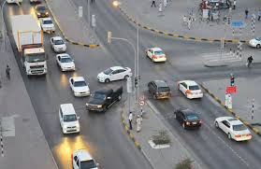

Slide 74
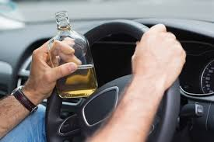

Slide 75


Slide 76
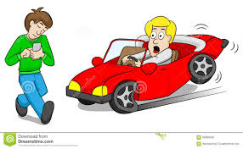

Slide 77
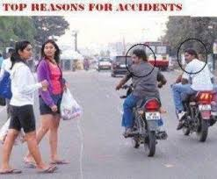

Slide 78
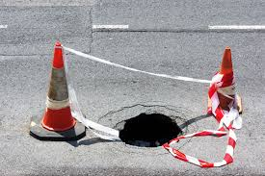

Slide 79
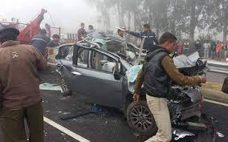

Slide 80
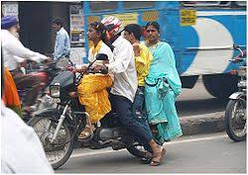

Slide 81
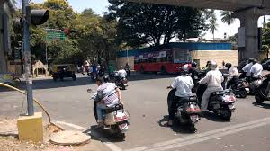

Slide 82
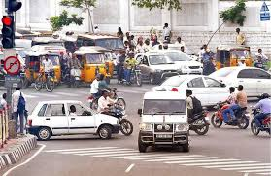

Slide 83
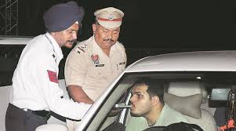

Slide 84
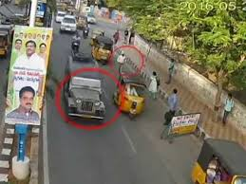

Slide 85
Analysis of Individual traffic accidents
Typical modes of vehicular accidents include:
Moving Vehicle collides with parked Vehicle
Two vehicles approaching from different directions collide at an intersection
Head-on collisions of two vehicles approaching from opposite directions
A moving vehicle collides with a stationary object like electric pole.

Slide 86
Moving Vehicle collides with parked Vehicle
Typical modes of vehicular accidents include:
Moving Vehicle collides with parked Vehicle
Two vehicles approaching from different directions collide at an intersection
Head-on collisions of two vehicles approaching from opposite directions
A moving vehicle collides with a stationary object like electric pole.

Slide 87


Slide 88
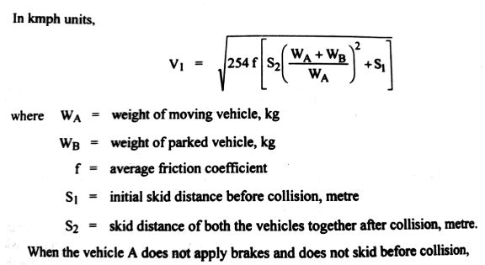
Moving Vehicle collides with parked Vehicle

Slide 89
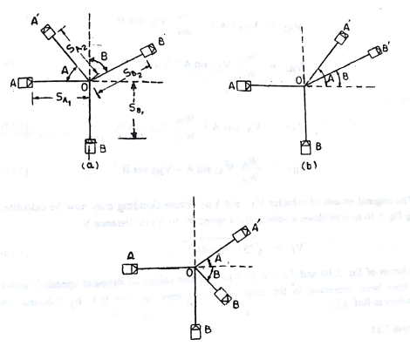
Two Vehicles approaching from right angles collide

Slide 90
